Slide 1

CSE431 DRAFT 2
SUICIDE RISK ASSESSMENT USING NLP AND MACHINE LEARNING
Submitted to: Annajiat Alim Rasel, Senior Lecturer, BRAC University
Submitted by:
Member 1: Hazra Mohammed Ahnaf Faiyaz , ID: 17241014
Member 2: Sadman Sakib Nabil , ID: 19101501
Group: 15
Task 5
RA: Md. Sabbir Hossain
ST: Mehnaz Ara Fazal
1

Slide 2
DATA ANALYSIS:
Utilized Kaggle's "Suicide and Depression Detection" dataset. Collected posts from "SuicideWatch" and "depression" subreddits via Pushshift API. Time span: SuicideWatch (Dec 16, 2008, to Jan 2, 2021), depression (Jan 1, 2009, to Jan 2, 2021).
Dataset contains 232074 textual data and contains three columns: Unnamed, Text, and Class.
Extracted 10,000 texts (Suicide: 4952, Non-suicide: 5048) for balanced outcomes.
Tested varying sample sizes (1000 to 100,000), achieving 88% accuracy with 10,000 samples.
2

Slide 3
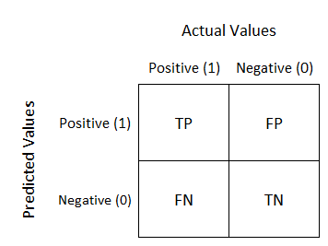
CONFUSION MATRIX:
A confusion matrix is a table used in machine learning and statistics to evaluate the performance of a classification model. It summarizes the results of the model's predictions by comparing them to the actual true values. The matrix has four entries: true positive (TP), false positive (FP), true negative (TN), and false negative (FN).
True Positive (TP): The model correctly predicted the positive class.
False Positive (FP): The model incorrectly predicted the positive class (Type I error).
True Negative (TN): The model correctly predicted the negative class.
False Negative (FN): The model incorrectly predicted the negative class (Type II error).
PRECISION, RECALL, AND F1-SCORE:
Precision, recall, and F1 score are performance metrics derived from the confusion matrix:
Precision: Ratio of true positives to the total number of predicted positives. A high precision indicates that the model has fewer false positives.
Recall: Ratio of true positives to the total number of actual positives. A high recall indicates that the model correctly identifies a large proportion of positive instances.
F1-Score: Harmonic mean of precision and recall. It provides a balanced measure that considers both false positives and false negatives.
3

Slide 4
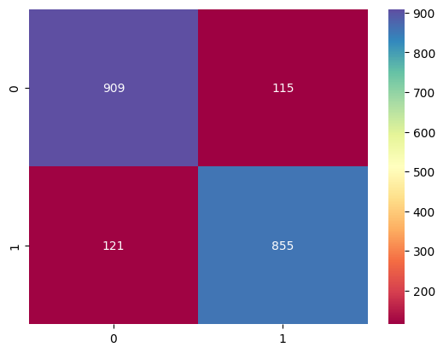
Precision: 909 /(115+909) = 0.8876953
Recall: 909/(909+121) = 0.8825242
Fig: Confusion Matrix of Naive Bayes Classifier
F1-Score: (2 x 0.8876953 x 0.8825242)/(0.8876953 + 0.8825242) = 0.8819904
4

Slide 5






RESULT ANALYSIS
Fig1: Precision,Recall, and F1-Score for Naive Bayes
Fig2: Precision,Recall, and F1-Score for KNN
Fig3: Precision,Recall, and F1-Score for Decision Tree
Fig4: Precision,Recall, and F1-Score for Random Forest
Fig5: Precision, Recall, and F1-Score for Gradient Boosting
5

Slide 6
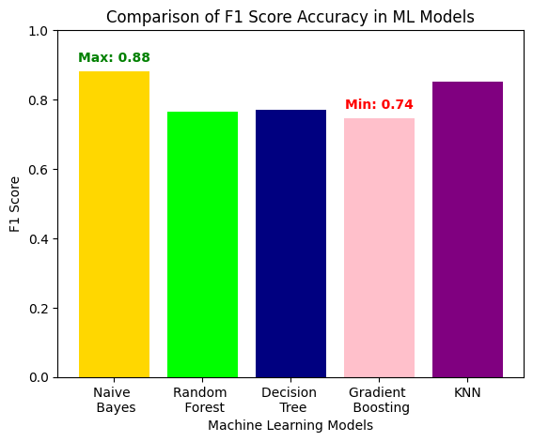
RESULT ANALYSIS
Fig6: Bar Chart Comparison of all models
6

Slide 7
LIMITATIONS
The dataset has been exclusively taken from the Reddit platform, which means it only caters to one specific group and may not give the same results for other platforms where textual data can be retrieved.
The study might not consider external factors influencing mental health, such as societal and economic conditions, which could impact the validity of the conclusions and predictions.
The choice of machine learning algorithms can impact the results. If the selected algorithms are not well-suited for the specific characteristics of depression and suicide data, the analysis may lack accuracy or fail to capture nuanced patterns.
The applicability of the findings to broader populations or diverse cultural contexts might be limited. Models trained on specific datasets may not perform equally well when applied to different demographics or socio-cultural backgrounds.
7

Slide 8
FUTURE WORK
Use data from various other platforms to combine all the textual data to build a larger dataset.
Incorporate the latest innovations in NLP and Machine Learning models to achieve higher accuracy overall.
Conduct longitudinal studies to track changes in suicide-related factors over time. Understanding the dynamic nature of these factors could provide insights into how interventions and societal changes impact suicide rates.
Develop more sophisticated machine learning models that can better predict and understand the complexities of suicide risk. This involves refining existing models, exploring new algorithms, and integrating diverse datasets for improved accuracy.
8

